Slide 1
Map-Reduce framework
-By Jagadish Rouniyar

Slide 2
Activities
10 students are given the task of counting words in a book “Big Data”
How they will perform it ? Identify the step . It denotes the map-reduce function

Slide 3
Map - reduce
sort/merge based distributed processing
• Best for batch- oriented processing
• Sort/merge is primitive
– Operates at transfer rate (Process+data clusters)
• Simple programming metaphor:
– input | map | shuffle | reduce > output
– cat * | grep | sort | uniq ­c > file
• Pluggable user code runs in generic reusable framework
– log processing,
-- web search indexing
– SQL like queries in PIG
• Distribution & reliability
– Handled by framework - transparency

Slide 4
MR model
Map()‏
Process a key/value pair to generate intermediate key/value pairs
Reduce()‏
Merge all intermediate values associated with the same key
Users implement interface of two primary methods:
1. Map: (key1, val1) → (key2, val2)
2. Reduce: (key2, [val2]) → [val3]
Map - clause group-by (for Key) of an aggregate function of SQL
Reduce - aggregate function (e.g., average) that is computed over all the rows with the same group-by attribute (key).

Slide 5
• Application writer specifies
– A pair of functions called Map and Reduce and a set of input files and submits the job
• Workflow
– Input phase generates a number of FileSplits from input files (one per Map task)
– The Map phase executes a user function to transform input kev-pairs into a new set of kev-pairs
– The framework sorts & Shuffles the kev-pairs to output nodes
– The Reduce phase combines all kev-pairs with the same key into new kevpairs
– The output phase writes the resulting pairs to files
• All phases are distributed with many tasks doing the work
– Framework handles scheduling of tasks on cluster
– Framework handles recovery when a node fails

Slide 6
Data distribution
Input files are split into M pieces on distributed file system - 128 MB blocks
Intermediate files created from map tasks are written to local disk
Output files are written to distributed file system
Assigning tasks
Many copies of user program are started
Tries to utilize data localization by running map tasks on machines with data
One instance becomes the Master
Master finds idle machines and assigns them tasks

Slide 7
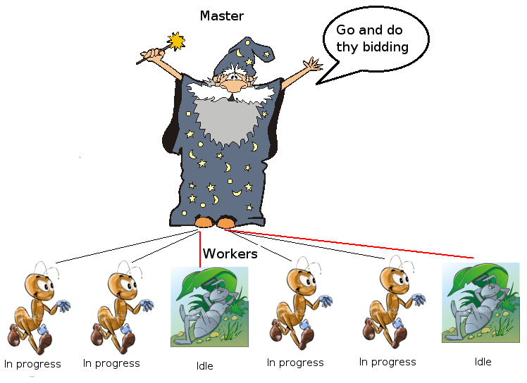

Slide 8
Execution
Map workers read in contents of corresponding input partition
Perform user-defined map computation to create intermediate <key,value> pairs
Periodically buffered output pairs written to local disk
Reduce
Reduce workers iterate over ordered intermediate data
Each unique key encountered – values are passed to user's reduce function
eg. <key, [value1, value2,..., valueN]>
Output of user's reduce function is written to output file on global file system
When all tasks have completed, master wakes up user program

Slide 9
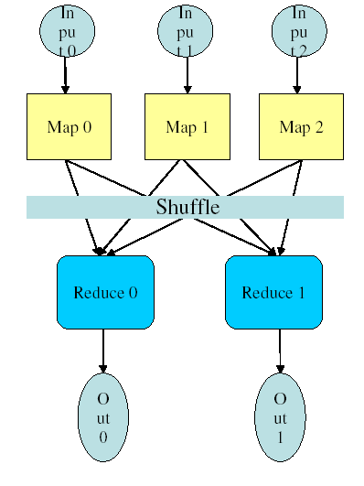

Slide 10
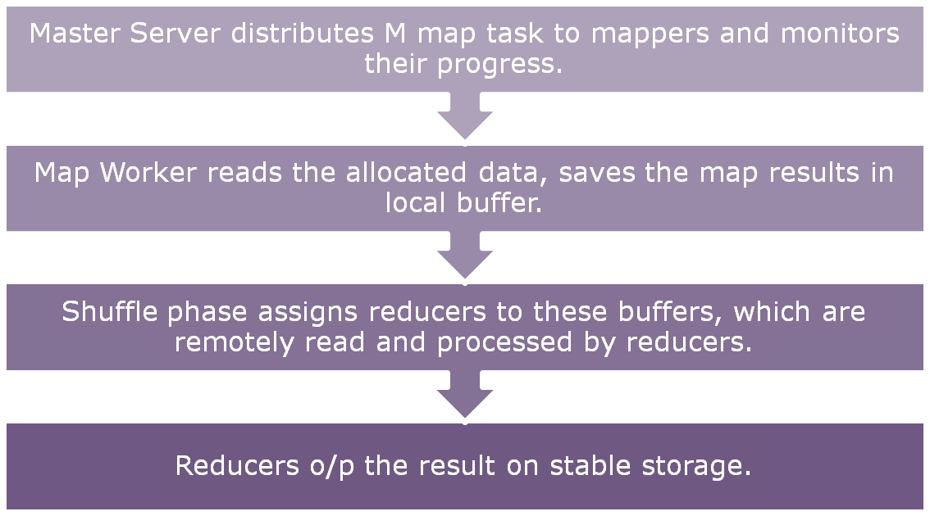

Slide 11
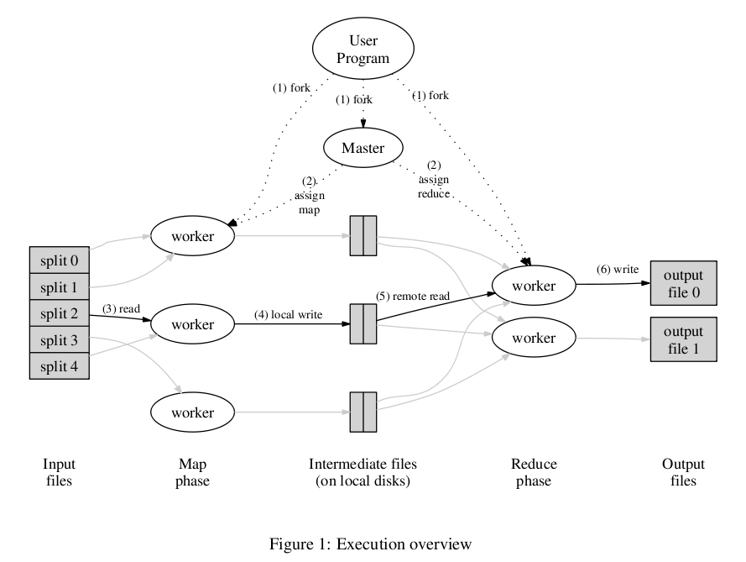

Slide 12
Data flow
Input, final output are stored on a distributed file system
Scheduler tries to schedule map tasks “close” to physical storage location of input data
Intermediate results are stored on local FS of map and reduce workers
Output is often input to another map reduce task

Slide 13
Coordination
Master data structures
Task status: (idle, in-progress, completed)
Idle tasks get scheduled as workers become available
When a map task completes, it sends the master the location and sizes of its R intermediate files, one for each reducer
Master pushes this info to reducers
Master pings workers periodically to detect failures

Slide 14
Failures
Map worker failure
Map tasks completed or in-progress at worker are reset to idle
Reduce workers are notified when task is rescheduled on another worker
Reduce worker failure
Only in-progress tasks are reset to idle
Master failure
MapReduce task is aborted and client is notified
Notes:
Why is completed map task discarded?

Slide 15
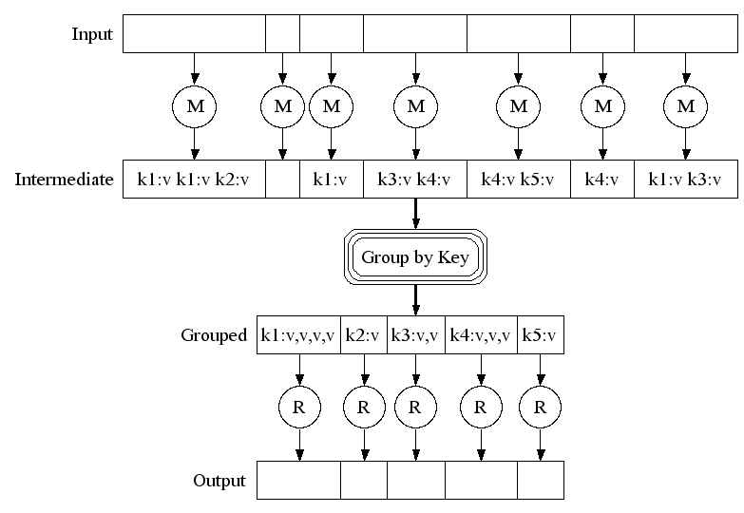
Execution
Notes:
View from task perspective

Slide 16
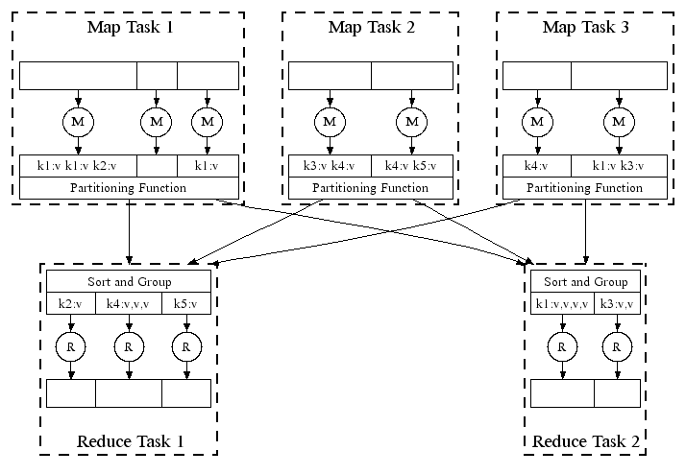
Parallel Execution
Notes:
View from scheduled m/c perspective

Slide 17
How many Map and Reduce jobs?
M map tasks, R reduce tasks
Rule of thumb:
Make M and R much larger than the number of nodes in cluster
One DFS chunk per map is common
Improves dynamic load balancing and speeds recovery from worker failure
Usually R is smaller than M, because output is spread across R files

Slide 18
Combiners
Often a map task will produce many pairs of the form (k,v1), (k,v2), … for the same key k
E.g., popular words in Word Count
Can save network time by pre-aggregating at mapper
combine(k1, list(v1)) → v2
Usually same as reduce function
Works only if reduce function is commutative and associative

Slide 19
Partition Function
Inputs to map tasks are created by contiguous splits of input file
For reduce, we need to ensure that records with the same intermediate key end up at the same worker
System uses a default partition function e.g., hash(key) mod R
Sometimes useful to override
E.g., hash(hostname(URL)) mod R ensures URLs from a host end up in the same output file

Slide 20
Execution Summary
How is this distributed?
Partition input key/value pairs into chunks, run map() tasks in parallel
After all map()s are complete, consolidate all emitted values for each unique emitted key
Now partition space of output map keys, and run reduce() in parallel
If map() or reduce() fails, reexecute!

Slide 21
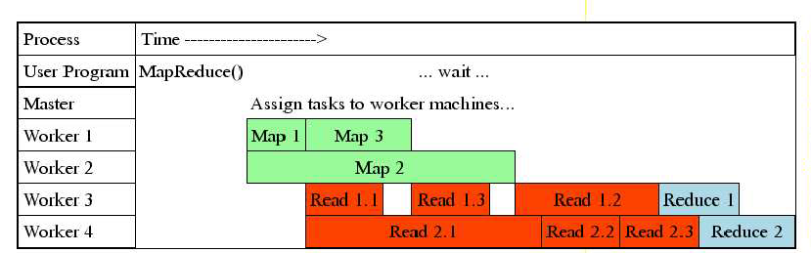

Slide 22
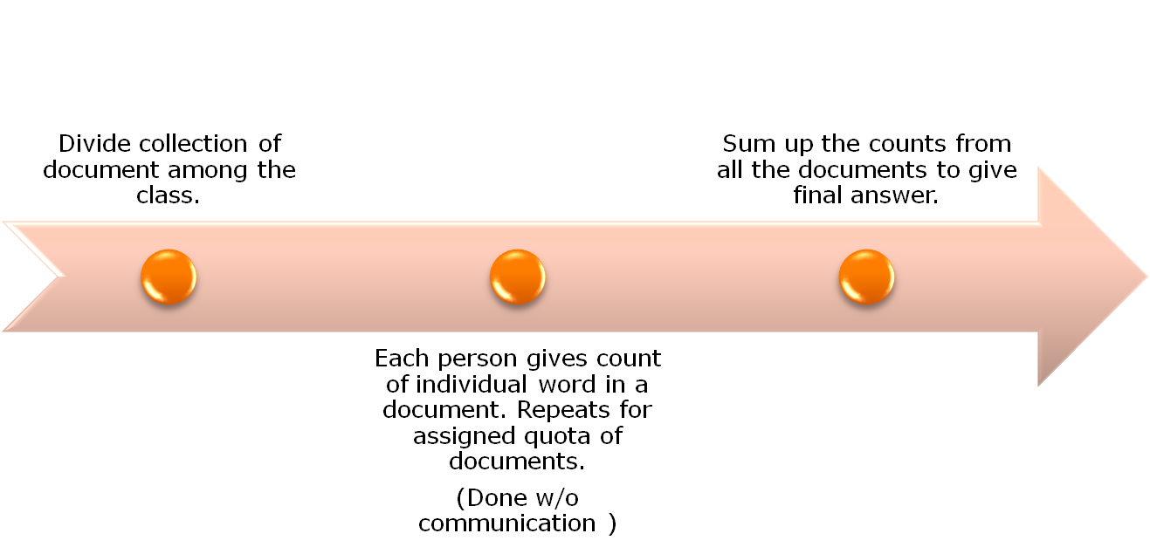
WORD COUNT EXAMPLE

Slide 23
map(String input_key, String input_value):
// input_key: document name
// input_value: document contents
for each word w in input_value:
EmitIntermediate(w, "1");
reduce(String output_key, Iterator intermediate_values):
// output_key: a word
// output_values: a list of counts
int result = 0;
for each v in intermediate_values:
result += ParseInt(v);
Emit(AsString(result));

Slide 24
Map()‏
Input <filename, file text>
Parses file and emits <word, count> pairs
eg. <”hello”, 1>
Reduce()‏
Sums all values for the same key and emits <word, TotalCount>
eg. <”hello”, (3 5 2 7)> => <”hello”, 17>

Slide 25
File
Hello World Bye World
Hello Hadoop GoodBye Hadoop
Map
For the given sample input the first map emits:
< Hello, 1>
< World, 1>
< Bye, 1>
< World, 1>
The second map emits:
< Hello, 1>
< Hadoop, 1>
< Goodbye, 1>
< Hadoop, 1>

Slide 26
The output of the first combine:
< Bye, 1>
< Hello, 1>
< World, 2>
The output of the second combine:
< Goodbye, 1>
< Hadoop, 2>
< Hello, 1>
Thus the output of the job (reduce) is:
< Bye, 1>
< Goodbye, 1>
< Hadoop, 2>
< Hello, 2>
< World, 2>

Slide 29
Map Reduce Architecture

Slide 30
Single-node architecture
CPU
Machine Learning, Statistics
Memory
“Classical” Data Mining
Disk

Slide 31
Commodity Clusters
Web data sets can be very large
Tens to hundreds of terabytes
Cannot mine on a single server (why?)
Standard architecture emerging:
Cluster of commodity Linux nodes
Gigabit ethernet interconnect
How to organize computations on this architecture?
Mask issues such as hardware failure
Notes:
On the software side: what is the programming model?
On the hardware side: how to deal with failures – hardware and data corruption?

Slide 32
Cluster Architecture
2-10 Gbps backbone between racks
1 Gbps between
any pair of nodes
in a rack
Switch
Switch
Switch
CPU
CPU
CPU
CPU
Mem
…
Mem
Mem
…
Mem
Disk
Disk
Disk
Disk
Each rack contains 16-64 nodes

Slide 33
Stable storage
First order problem: if nodes can fail, how can we store data persistently?
Answer: Distributed File System
Provides global file namespace
Google GFS; Hadoop HDFS; Kosmix KFS
Typical usage pattern
Huge files (100s of GB to TB)
Data is rarely updated in place
Reads and appends are common
Notes:
DFS: provides a unified view of the file system and hides the details of replication and consistency management

Slide 34
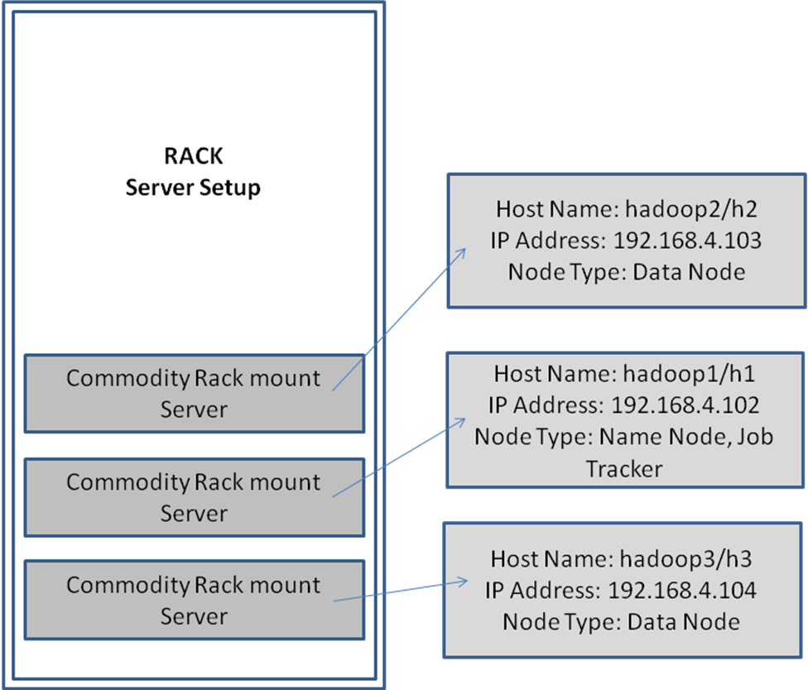
Configuration

Slide 35
Hadoop : Map reduce framework
Hadoop Map-Reduce is a software framework for easily writing applications which process vast amounts of data (multi-terabyte data-sets) in-parallel on large clusters (thousands of nodes) of commodity hardware in a reliable, fault-tolerant manner.

Slide 36
Functional Programming
functional languages : Take example of Programming model from Lisp

Slide 37
Map in Lisp (Scheme)
Unary operator
(map f list [list₂ list₃ …])
(map square ‘(1 2 3 4))
(1 4 9 16)
(reduce + ‘(1 4 9 16))
(+ 16 (+ 9 (+ 4 1) ) )
30
(reduce + (map square (map – l₁ l₂))))
Binary operator

Slide 38
Fault Tolerance
Workers are periodically pinged by master
No response = failed worker
Master writes periodic checkpoints
On errors, workers send “last gasp” UDP packet to master
Detect records that cause deterministic crashes and skips them

Slide 39
Fault Tolerance
Input file blocks stored on multiple machines
When computation almost done, reschedule in-progress tasks

Slide 40
Fault Tolerance / Workers
Handled via re-execution
Detect failure via periodic heartbeats
Re-execute completed + in-progress map tasks
Why????
Re-execute in progress reduce tasks
Task completion committed through master

Slide 41
Master Failure
Could handle, … ?
But don't yet
(master failure unlikely)

Slide 42
Refinement: Redundant Execution
Slow workers significantly delay completion time
Other jobs consuming resources on machine
Bad disks w/ soft errors transfer data slowly
Weird things: processor caches disabled (!!)
Solution: Near end of phase, spawn backup tasks
Whichever one finishes first "wins"
Dramatically shortens job completion time

Slide 43
Refinement: Locality Optimization
Master scheduling policy:
Asks GFS for locations of replicas of input file blocks
Map tasks typically split into 64MB (GFS block size)
Map tasks scheduled so GFS input block replica are on same machine or same rack
Effect
Thousands of machines read input at local disk speed
Without this, rack switches limit read rate

Slide 44
Refinement Skipping Bad Records
Map/Reduce functions sometimes fail for particular inputs
Best solution is to debug & fix
Not always possible ~ third-party source libraries
On segmentation fault:
Send UDP packet to master from signal handler
Include sequence number of record being processed
If master sees two failures for same record:
Next worker is told to skip the record

Slide 45
Other Refinements
Sorting guarantees
within each reduce partition
Compression of intermediate data
Combiner
Useful for saving network bandwidth
Local execution for debugging/testing
User-defined counters

Slide 46
Performance
Tests run on cluster of 1800 machines:
4 GB of memory
Dual-processor 2 GHz Xeons with Hyperthreading
Dual 160 GB IDE disks
Gigabit Ethernet per machine
Bisection bandwidth approximately 100 Gbps
Two benchmarks:
MR_GrepScan 1010 100-byte records to extract records matching a rare pattern (92K matching records)
MR_SortSort 1010 100-byte records (modeled after TeraSort
benchmark)

Slide 47
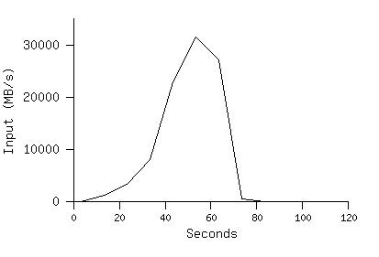
MR_Grep
Locality optimization helps:
1800 machines read 1 TB at peak ~31 GB/s
W/out this, rack switches would limit to 10 GB/s
Startup overhead is significant for short jobs

Slide 48
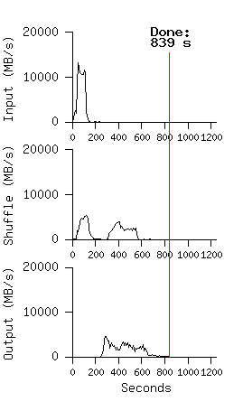
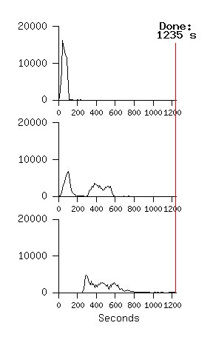
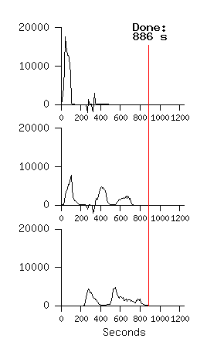
MR_Sort
Normal No backup tasks 200 processes killed
Backup tasks reduce job completion time a lot!
System deals well with failures

Slide 49
Usage in Aug 2004
Number of jobs 29,423
Average job completion time 634 secs
Machine days used 79,186 days
Input data read 3,288 TB
Intermediate data produced 758 TB
Output data written 193 TB
Average worker machines per job 157
Average worker deaths per job 1.2
Average map tasks per job 3,351
Average reduce tasks per job 55
Unique map implementations 395
Unique reduce implementations 269
Unique map/reduce combinations 426

